Slide 1
DSAM TAC Tip #2
Cannot get Reverse sweep.

Slide 2
Why reverse sweep does not work?
Problem: Customers will compain that the unit will not reverse sweep.
Solution: Not enough return level output.
Must set the Test point compensation.

Slide 3
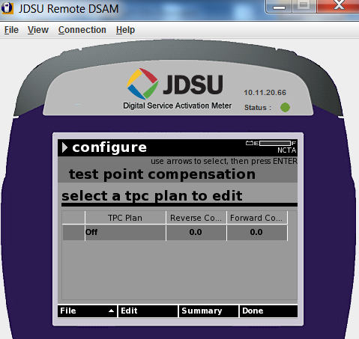
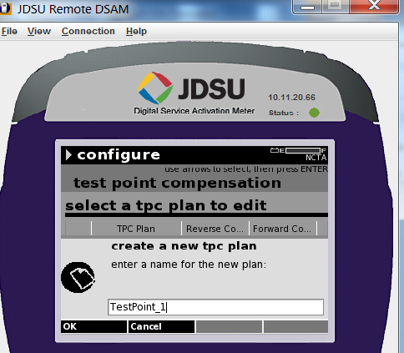
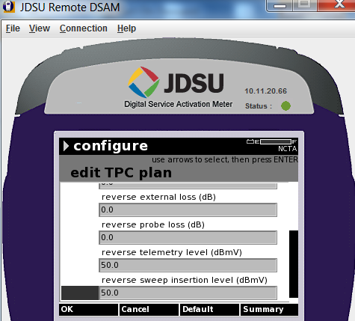
Setting the reverse Testpoint Compensation.
Edit to create a to tpc plan
Set reverse telemetry to 50
Set reverse sweep insertion to 50
Press blue 4

