Slide 1
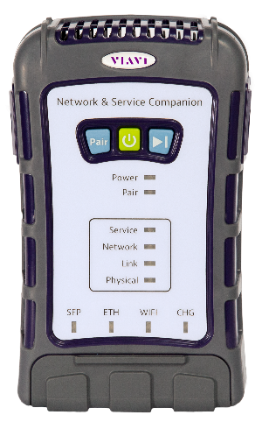

Quick Card
Network & Service Companion (NSC-100)
1G & 10G LOOPBACK
June 8, 2021
NSC 3.0.10
MTA 4.4

Slide 2


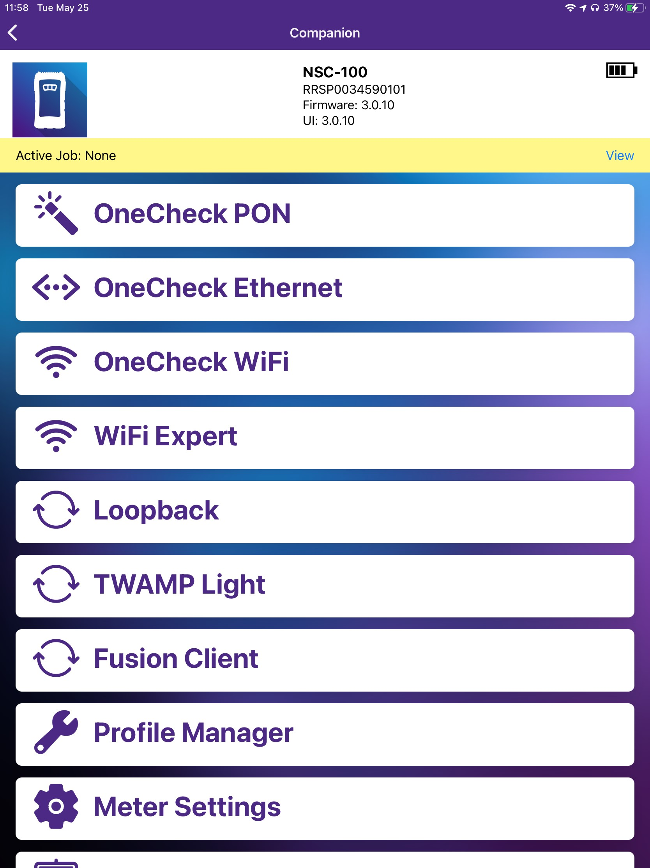
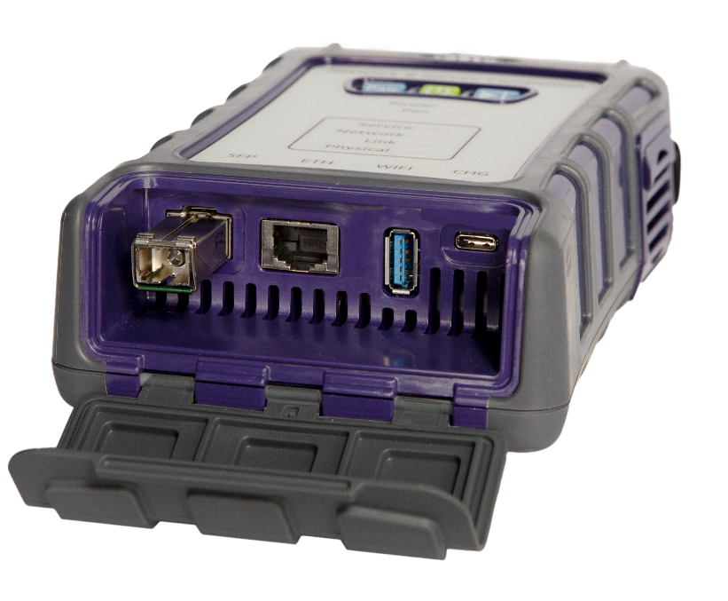

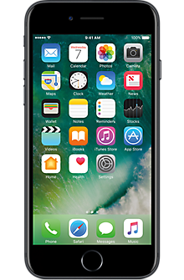
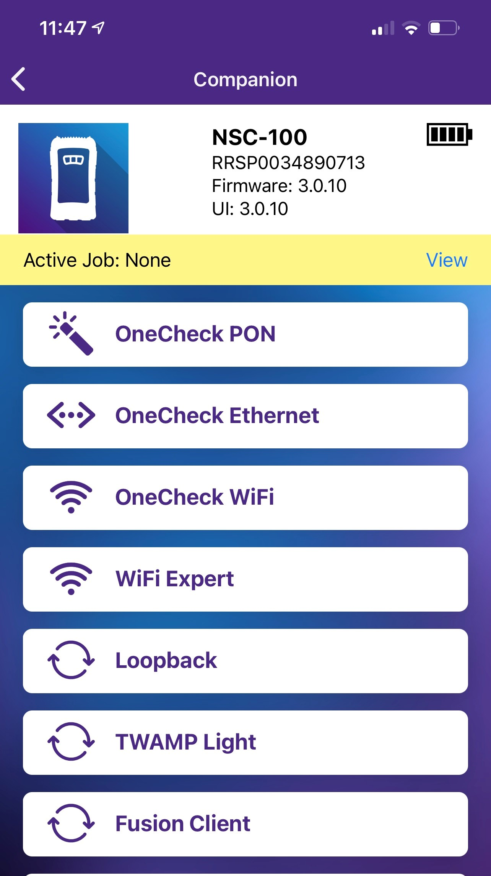

VIAVI Companion
1G & 10G Loopback
Controlling Device
VIAVI Mobile Tech App (MTA)
NSC-100
RJ45
Electrical 1G Ethernet
SFP+
Optical 1G Ethernet SFP
Optical/Electrical 10G Ethernet SFP+
Download “VIAVI Mobile Tech”
from App Store or Google Play

Slide 3
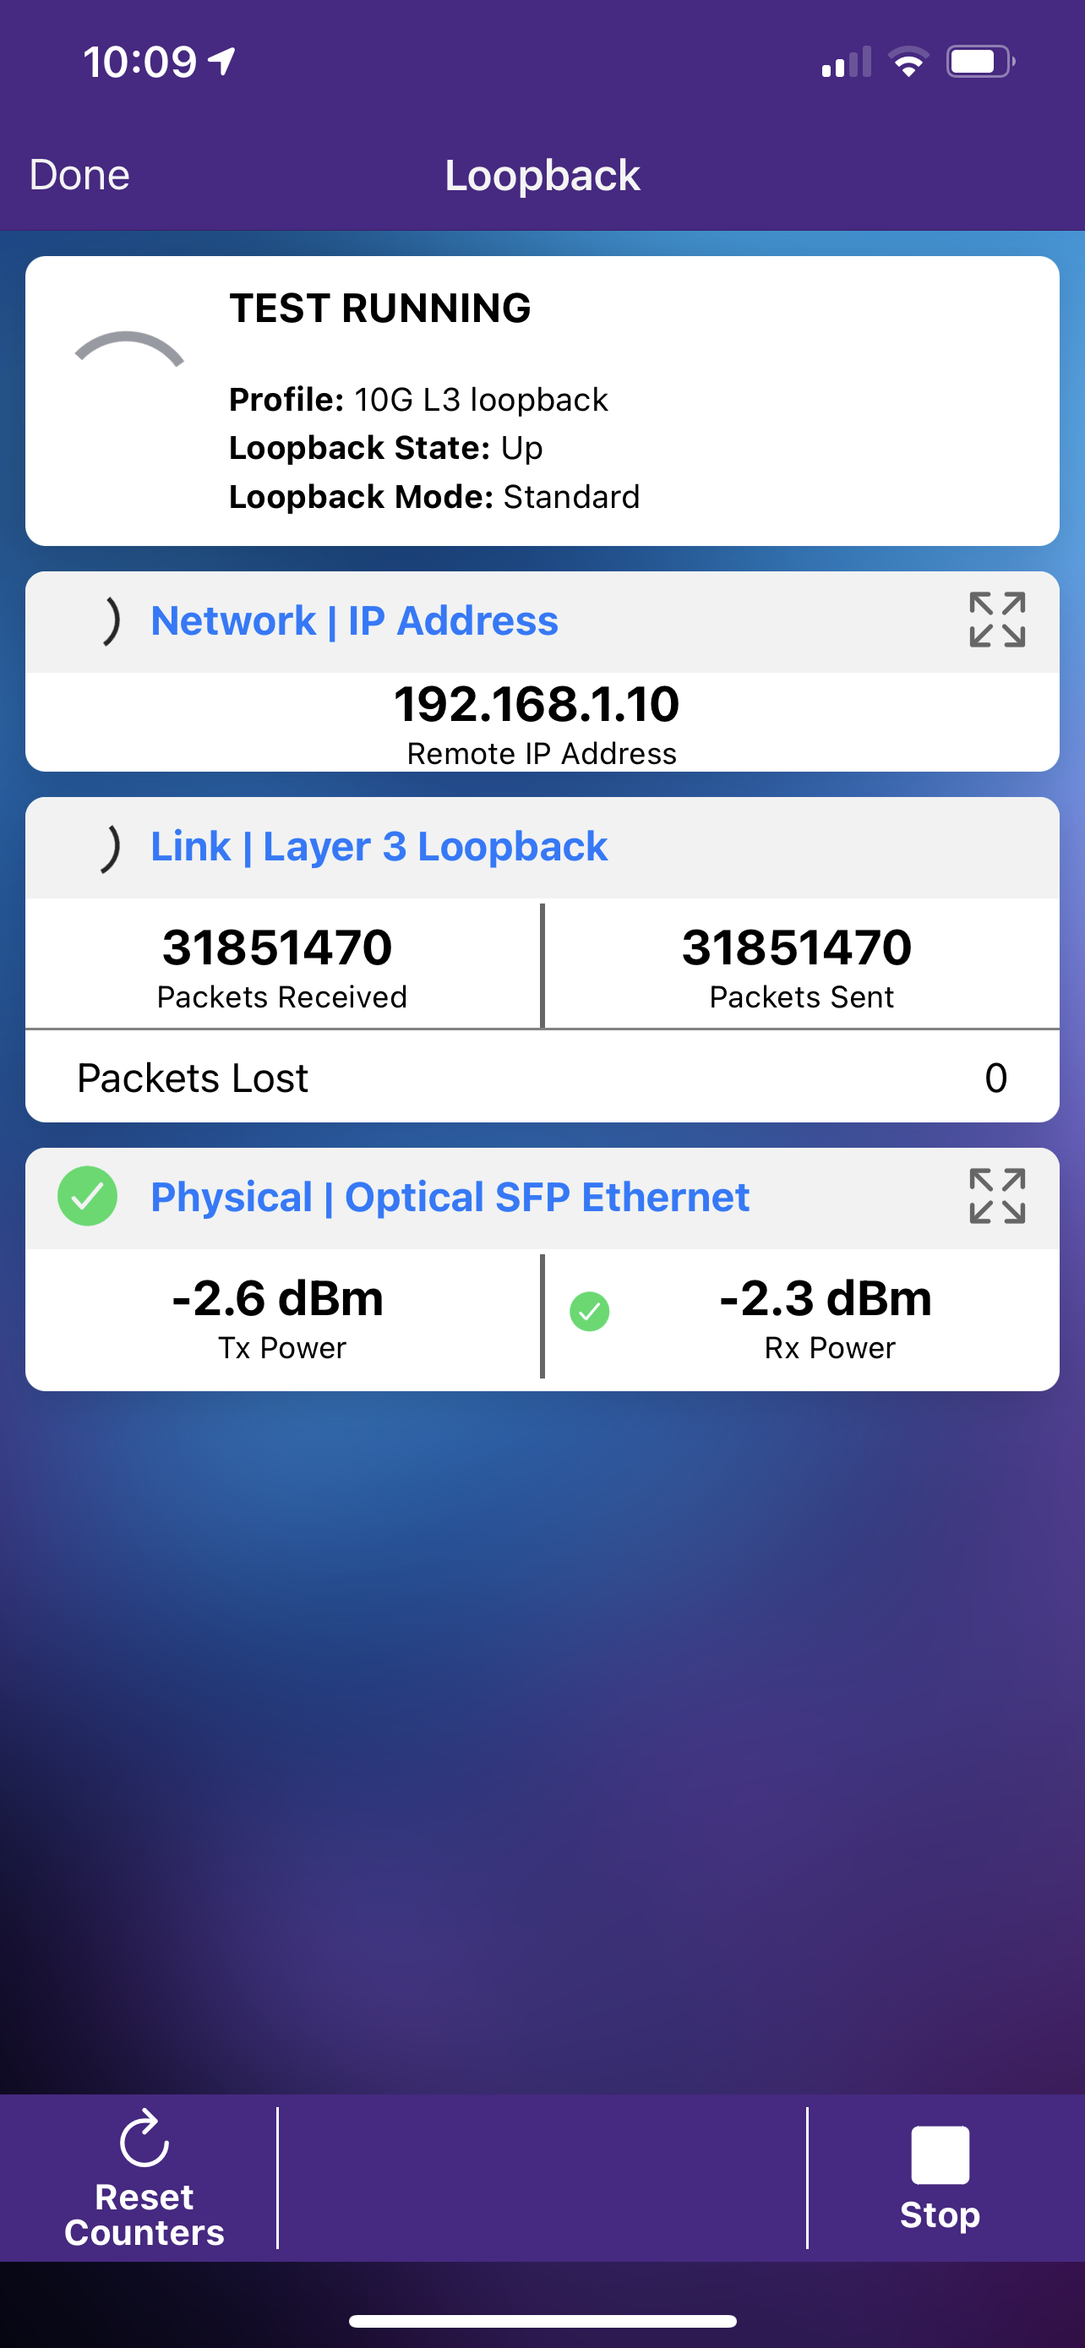
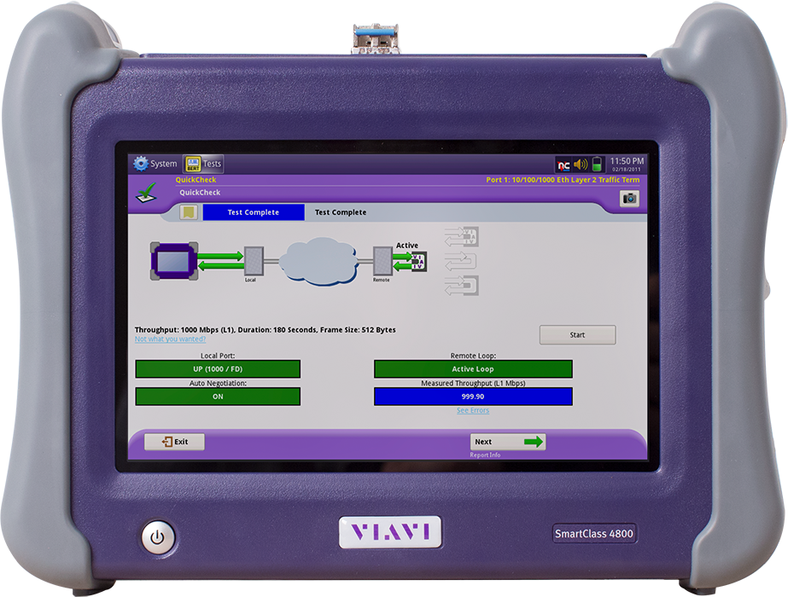
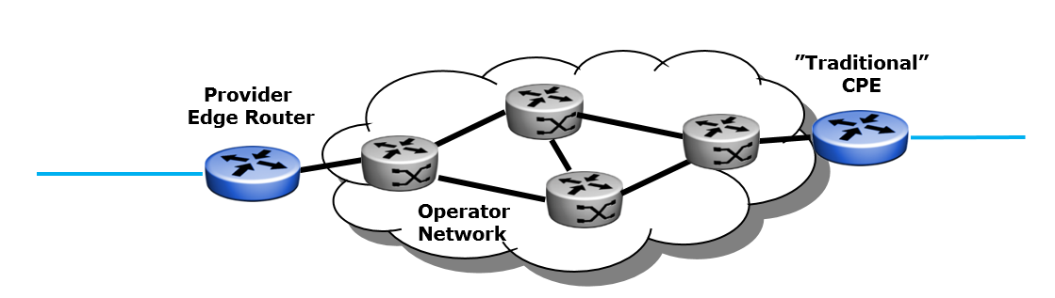
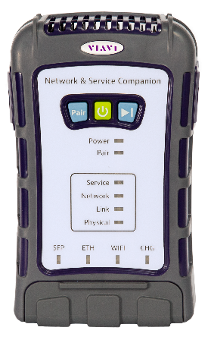
Enterprise Ethernet
1G & 10G Loopback
10G Links with SLA
Service Activation & Maintenance Tests
Very easy setup, 1-man job, cheaper E2E test
L3 Loopback
L2 Loopback
Port Loopback
RFC-2544 or Y.1564
Traffic Gen
Circuit SLA up to 10 Gbps
SmartClass 4800
Companion
4800
Loop Up /Down Commands
+ Traffic
Companion
in Loopback Test Mode
(24/7 leave behind)

Slide 4
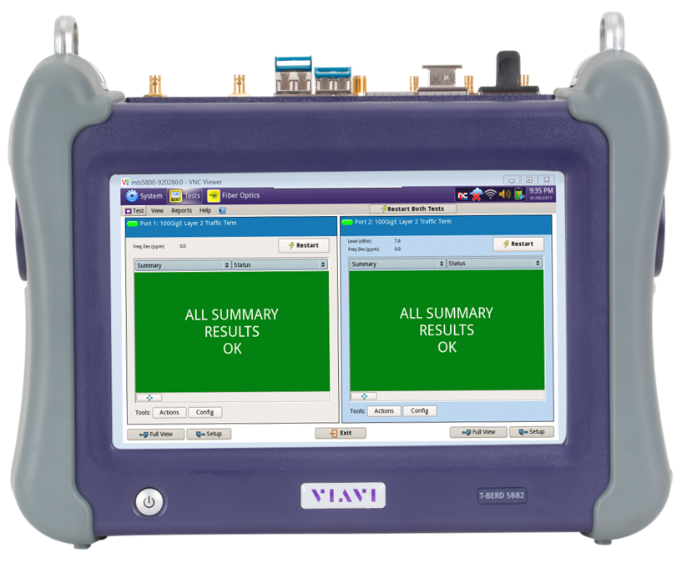
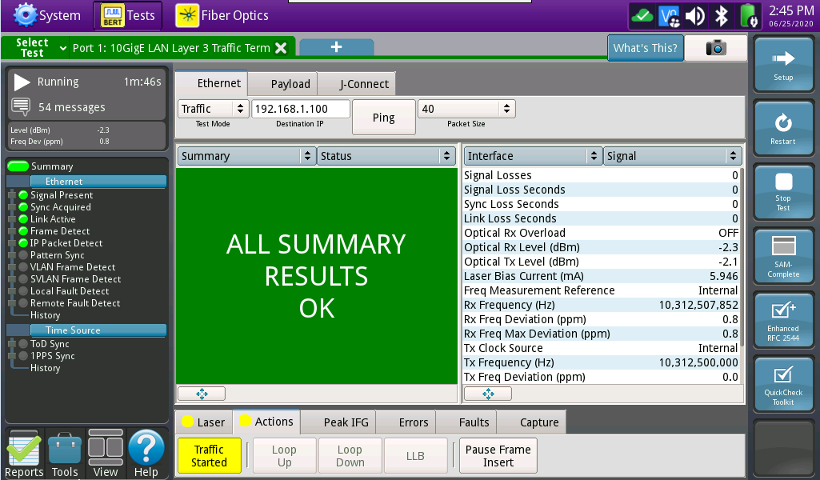
Enterprise Ethernet
1G & 10G Loopback
10G Links with SLA
Service Activation & Maintenance Tests
Very easy setup, 1-man job, cheaper E2E test
L3 Loopback
L2 Loopback
Port Loopback
RFC-2544 or Y.1564
Traffic Gen
Circuit SLA up to 10 Gbps
T-BERD/MTS 5800
Companion
5800
Loop Up /Down Commands
+ Traffic
Companion
in Loopback Test Mode
(24/7 leave behind)

Slide 5
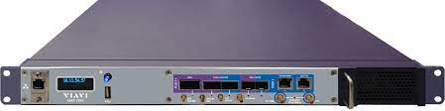
Enterprise Ethernet
1G & 10G Loopback
10G Links with SLA
Service Activation & Maintenance Tests
Very easy setup, 1-man job, cheaper E2E test
L3 Loopback
L2 Loopback
Port Loopback
RFC-2544 or Y.1564
Traffic Gen
Circuit SLA up to 10 Gbps
MAP-2100
Companion
2100
Loop Up /Down Commands
+ Traffic
Companion
in Loopback Test Mode
(24/7 leave behind)

Slide 6
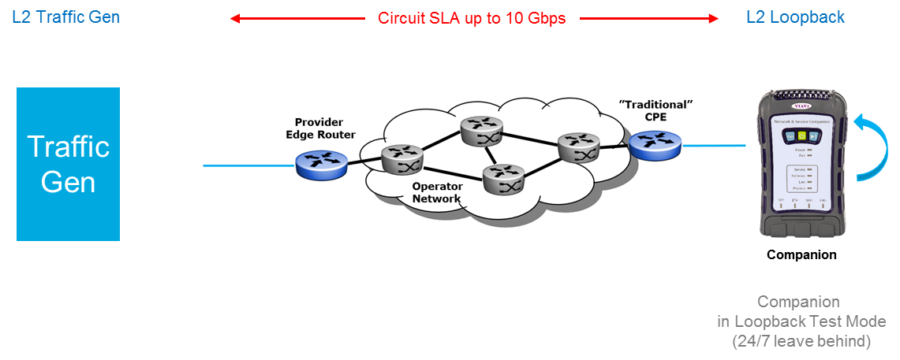
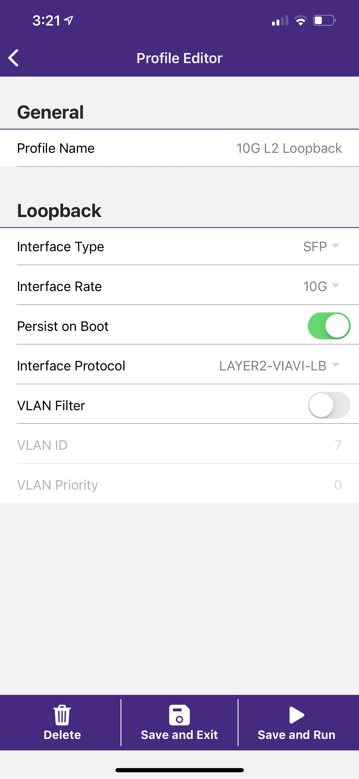
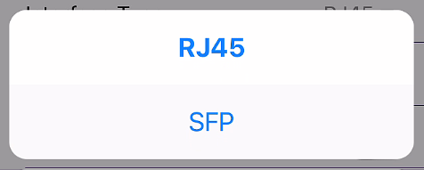
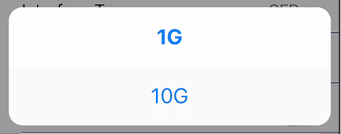
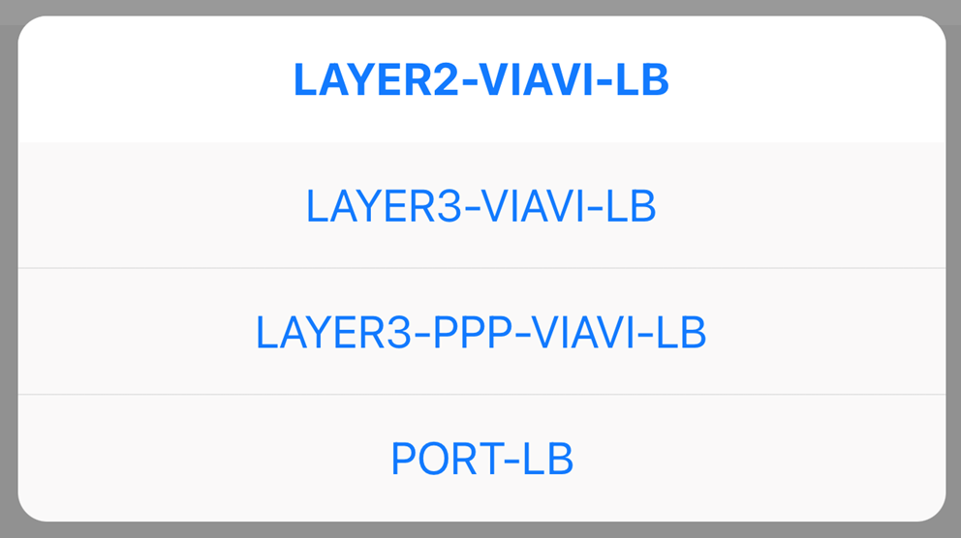
L2 Loopback
Test Profile (Setup)
Loop Up Command required
All Frames sent by the Remote Device are looped back with the MAC addresses swapped
Interface Type
RJ45 – built-in 1000BaseT (only 1GE supported)
SFP – Optical/Ethernet 1G or 10G SFP+)
Persist on Boot
Enabled
Loopback test resumes with this profile after reboot (loss of power while left behind or unit preset before being shipped to test site)
Interface Rate
1G for 1GE
10G for 10GigE
(correct SFP/SFP+ must be plugged in)
VLAN Filter
Disabled
All tagged or untagged test frames are looped
Enabled
Only test frames with correct
VLAN ID and VLAN Priority are looped
Interface Protocol
LAYER2-VIAVI-LB
for Layer 2 Ethernet Loop
J-Proof supported (with 10G Loopback only)

Slide 7
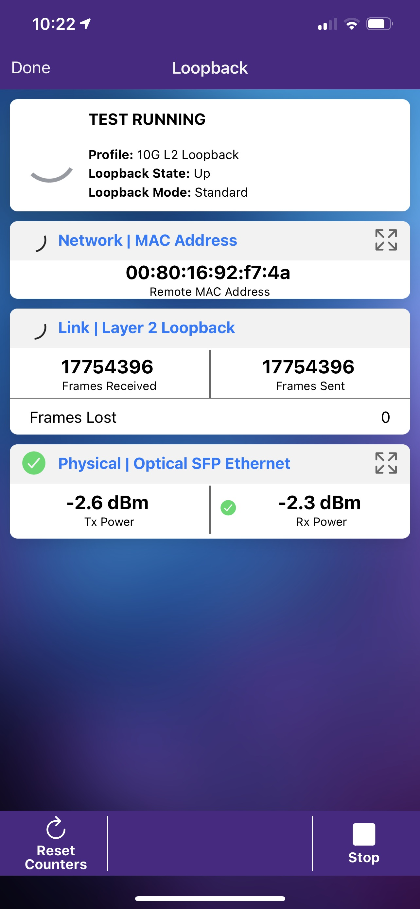
L2 Loopback
Test Results
Loop Up Command required
All Frames sent by the Remote Device are looped back with the MAC addresses swapped
Incoming Loop Up Command (with Destination address matching the MAC address of the NSC) will be acknowledged
Test Running
NSC ready to be looped
Remote Traffic Generator
00:00:00:00:00:00:00 -> Loop is down
MAC of the remote unit -> Loop is up
Link Counters
Counts Frames received from the Remote Device
(same MAC which sent the Loop Up command) and sent (looped back) from the NSC
Frame Lost Counter
Counts received Errored Frames
(only supported with 10G Loopback)

Slide 8

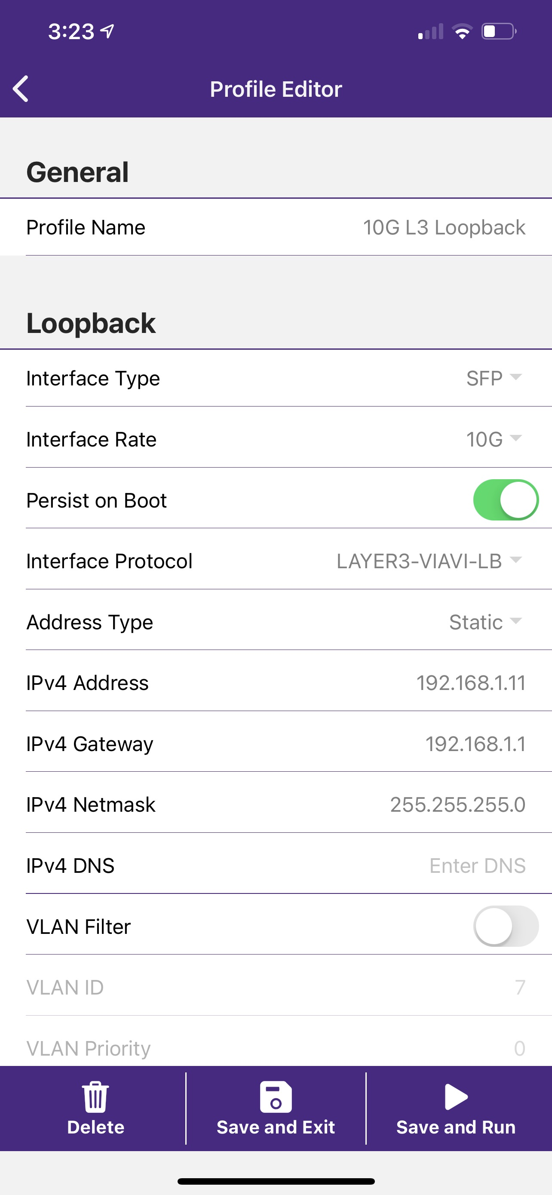
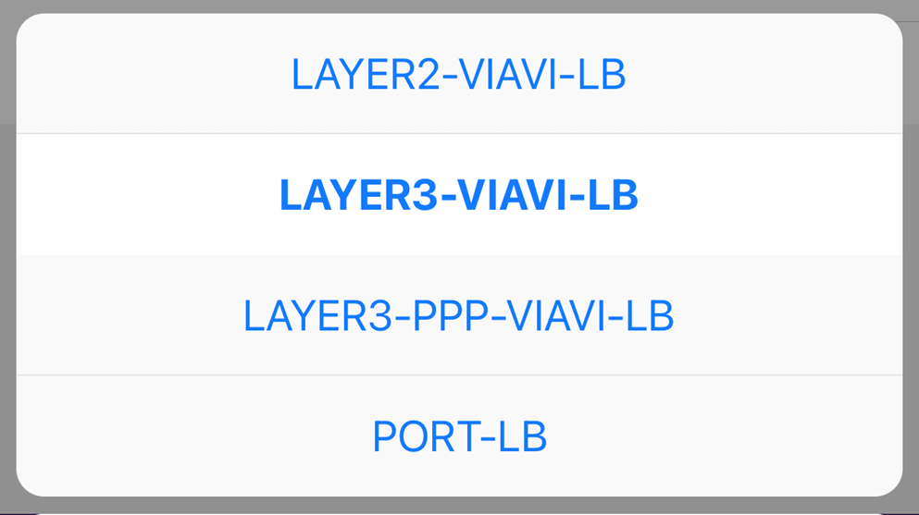
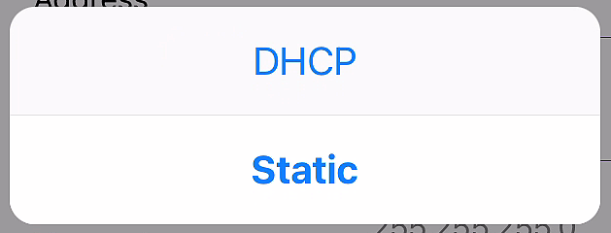
L3 Loopback
Test Profile (Setup)
Loop Up Command required
All Packets sent by the Remote Device are looped back with the MAC & IP addresses swapped
Interface Type
RJ45 – built-in 1000BaseT (only 1GE supported)
SFP – Optical/Ethernet 1G or 10G SFP+)
Persist on Boot
Enabled
Loopback test resumes with this profile after reboot (loss of power while left behind or unit preset before being shipped to test site)
Interface Rate
1G for 1GE
10G for 10GigE
(correct SFP/SFP+ must be plugged in)
VLAN Filter
Disabled
All tagged or untagged test packets are looped
The NSC replies to all tagged & untagged ARPs
Enabled
Only test packets with correct
VLAN ID and VLAN Priority are looped
The NSC only replies to ARPs
received with the correct VLAN ID
Interface Protocol
LAYER3-VIAVI-LB
for Layer 3 IP Loop
Address Type
DHCP server or
Static IP

Slide 9
L3 Loopback
Test Results
Loop Up Command required
All Packets sent by the Remote Device are looped back
with the MAC & IP addresses swapped
Incoming Loop Up Command (with Destination address matching the IP address of the NSC) will be acknowledged
Test Running
NSC ready to be looped
Remote Traffic Generator
Blank -> Loop is down
IP of the remote unit -> Loop is up
Link Counters
Counts Packets received from the Remote Device
(same IP which sent the Loop Up command) and sent (looped back) from the NSC
Packet Lost Counter
Counts received Errored Packets
(only supported with 10G Loopback)

Slide 10
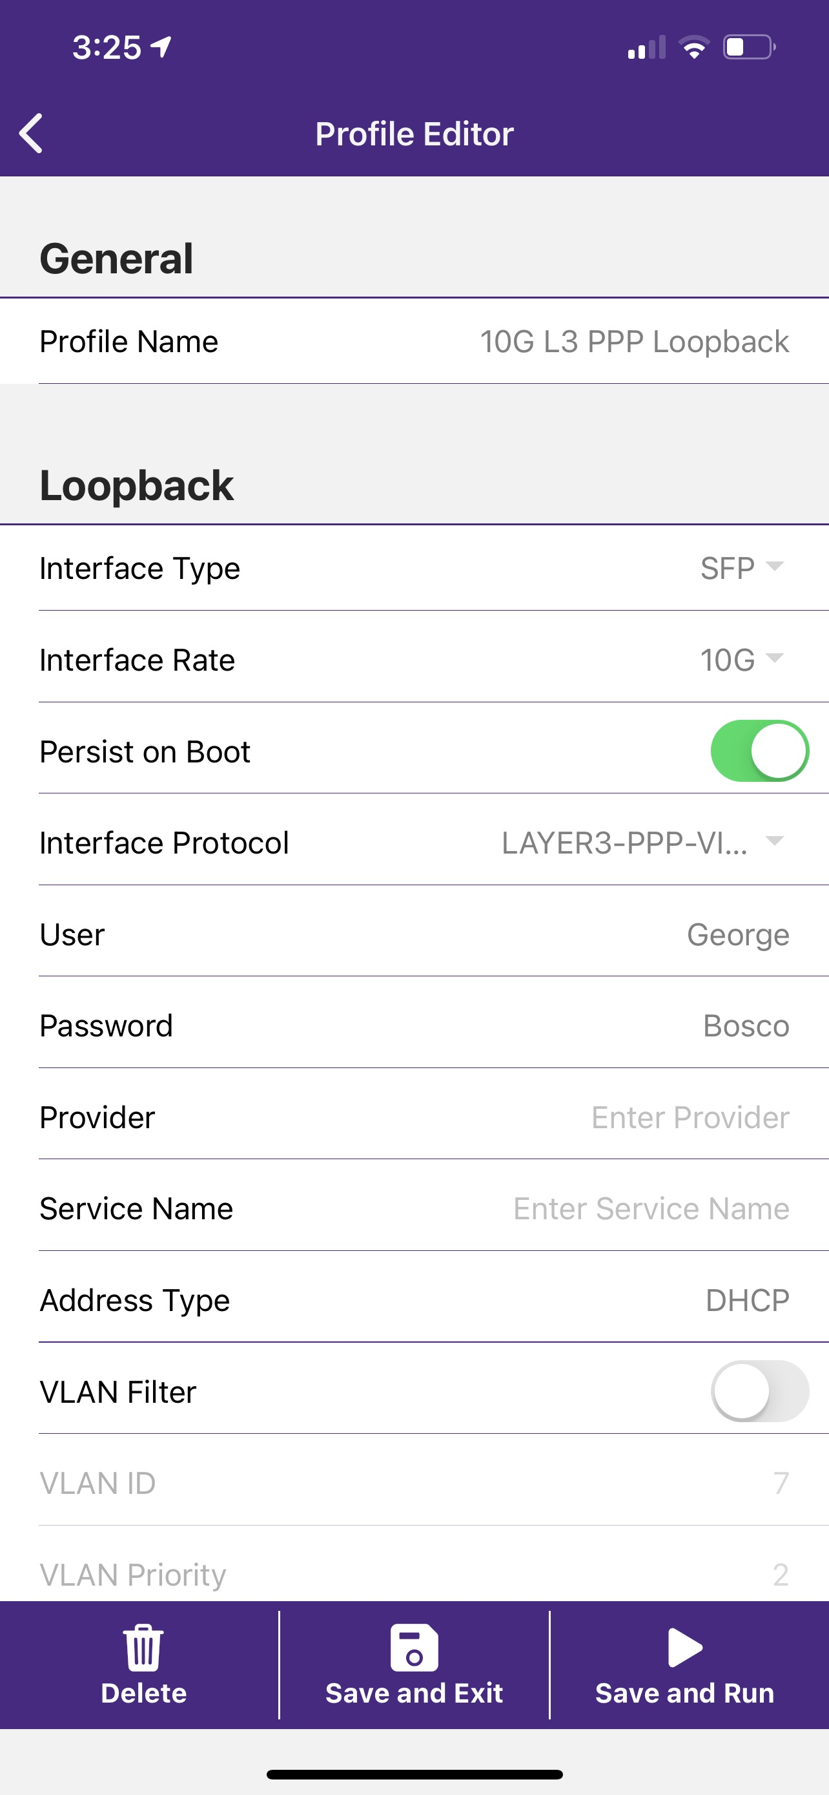
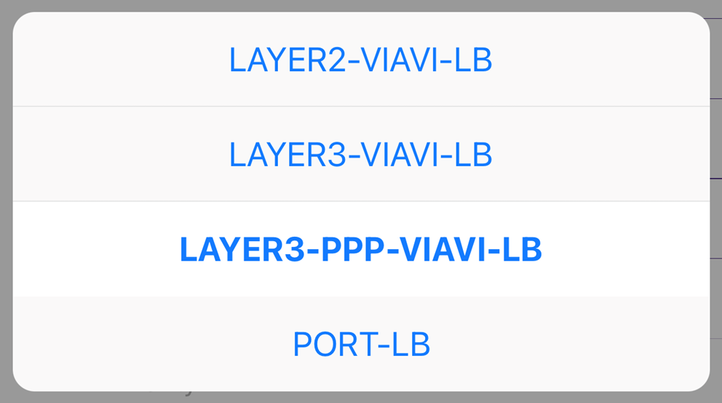
L3 PPPoE Loopback
Test Profile (Setup)
Loop Up Command required
All Packets sent by the Remote Device are looped back
with the MAC & IP addresses swapped
Interface Type
RJ45 – built-in 1000BaseT (only 1GE supported)
SFP – Optical/Ethernet 1G or 10G SFP+)
Persist on Boot
Enabled
Loopback test resumes with this profile after reboot (loss of power while left behind or unit preset before being shipped to test site)
Interface Rate
1G for 1GE
10G for 10GigE
(correct SFP/SFP+ must be plugged in)
PPPoE
Credentials (Username & Password)
VLAN Filter
Disabled
All tagged or untagged test packets are looped
Enabled
Only test packets with correct
VLAN ID and VLAN Priority are looped
Interface Protocol
LAYER3-PPP-VIAVI-LB
for Layer 3 IP Loop
(only supported with 10G Loopback)

Slide 11
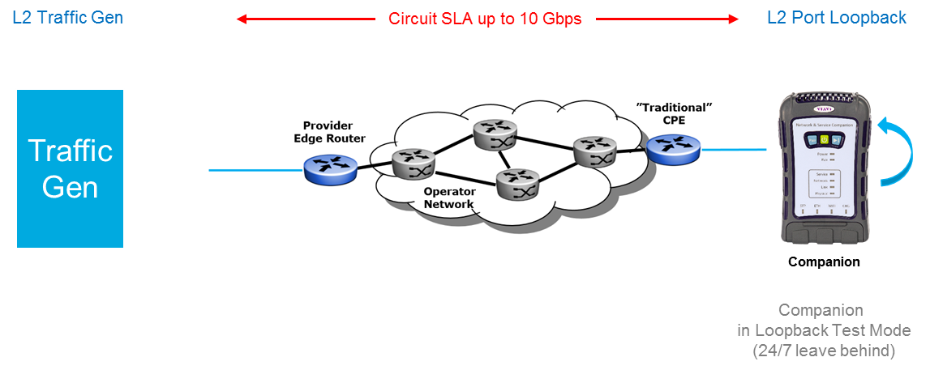
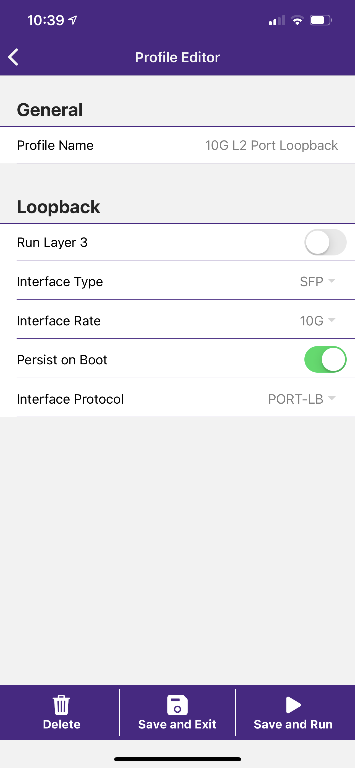
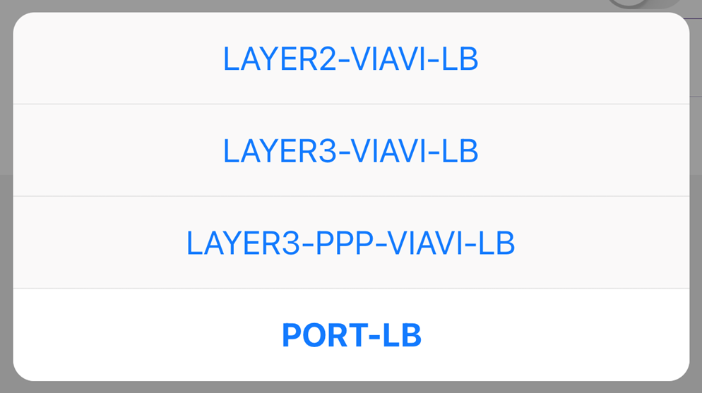
L2 Port Loopback
Test Profile (Setup)
No Loop Up Command required
All Frames (except multicast/broadcast) are looped back
with the MAC addresses swapped
Interface Type
RJ45 – built-in 1000BaseT (only 1GE supported)
SFP – Optical/Ethernet 1G or 10G SFP+)
Persist on Boot
Enabled
Loopback test resumes with this profile after reboot (loss of power while left behind or unit preset before being shipped to test site)
Interface Rate
1G for 1GE
10G for 10GigE
(correct SFP/SFP+ must be plugged in)
All tagged or untagged test frames are looped
Interface Protocol
PORT-LB
for Layer 2 Ethernet Loop

Slide 12
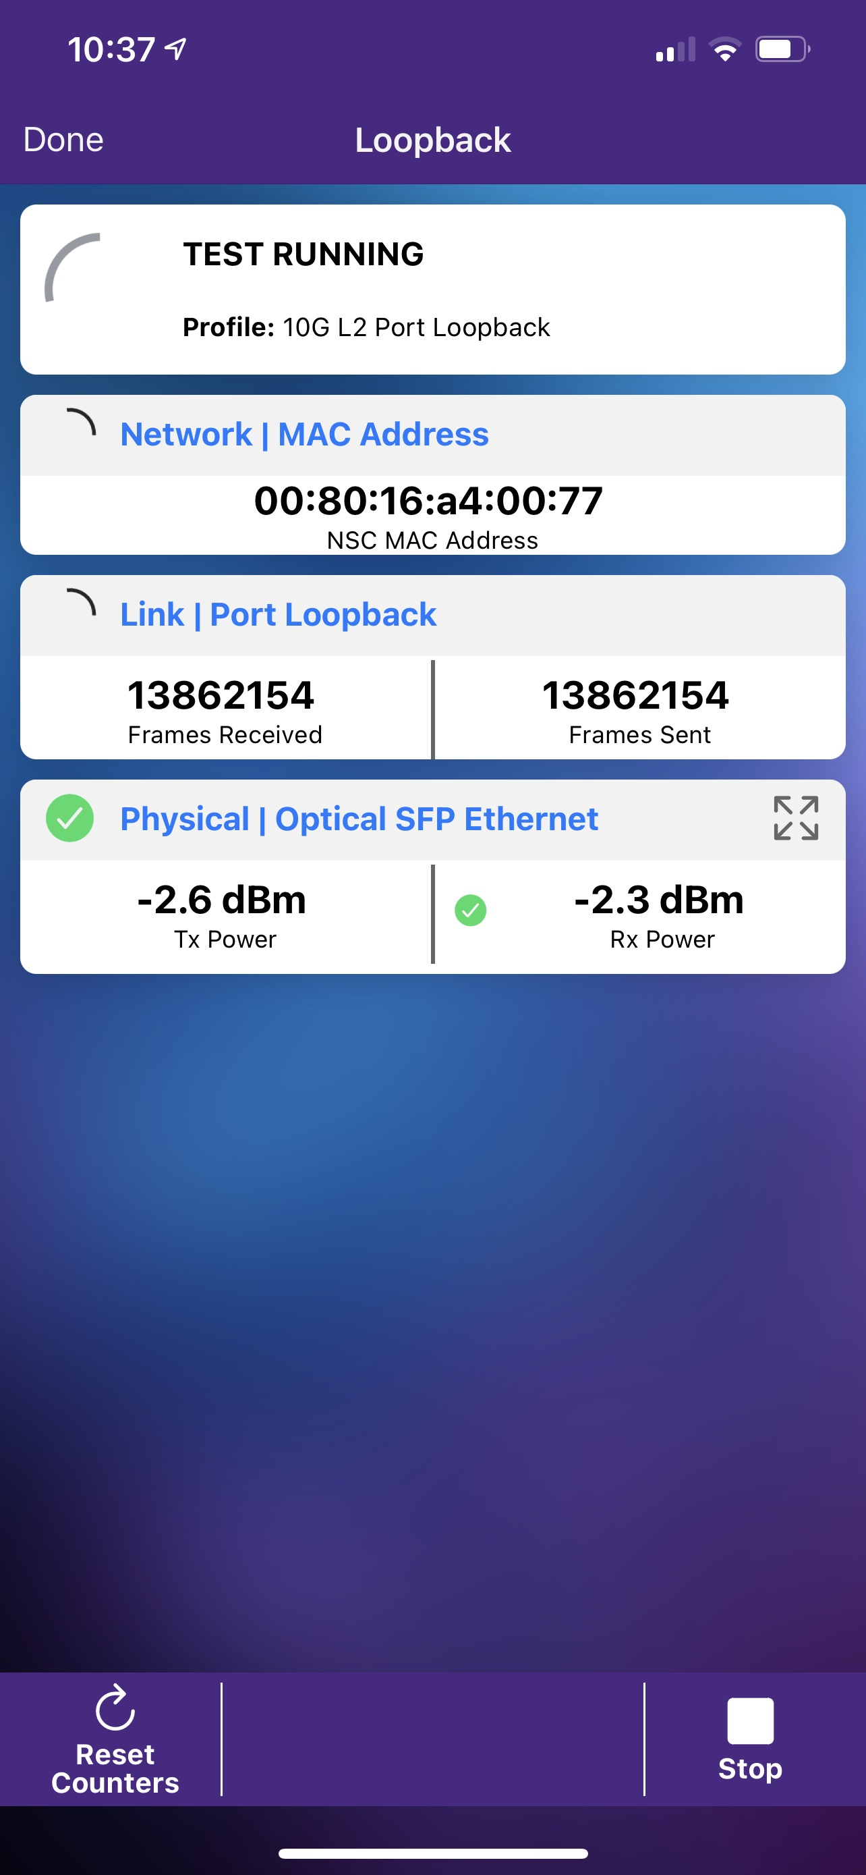
L2 Port Loopback
Test Results
No Loop Up Command required
All Frames (except multicast/broadcast) are looped back
with the MAC addresses swapped
Test Running
NSC ready to be looped
Link Counters
Counts any Frames
received and transmitted
back from the NSC

Slide 13

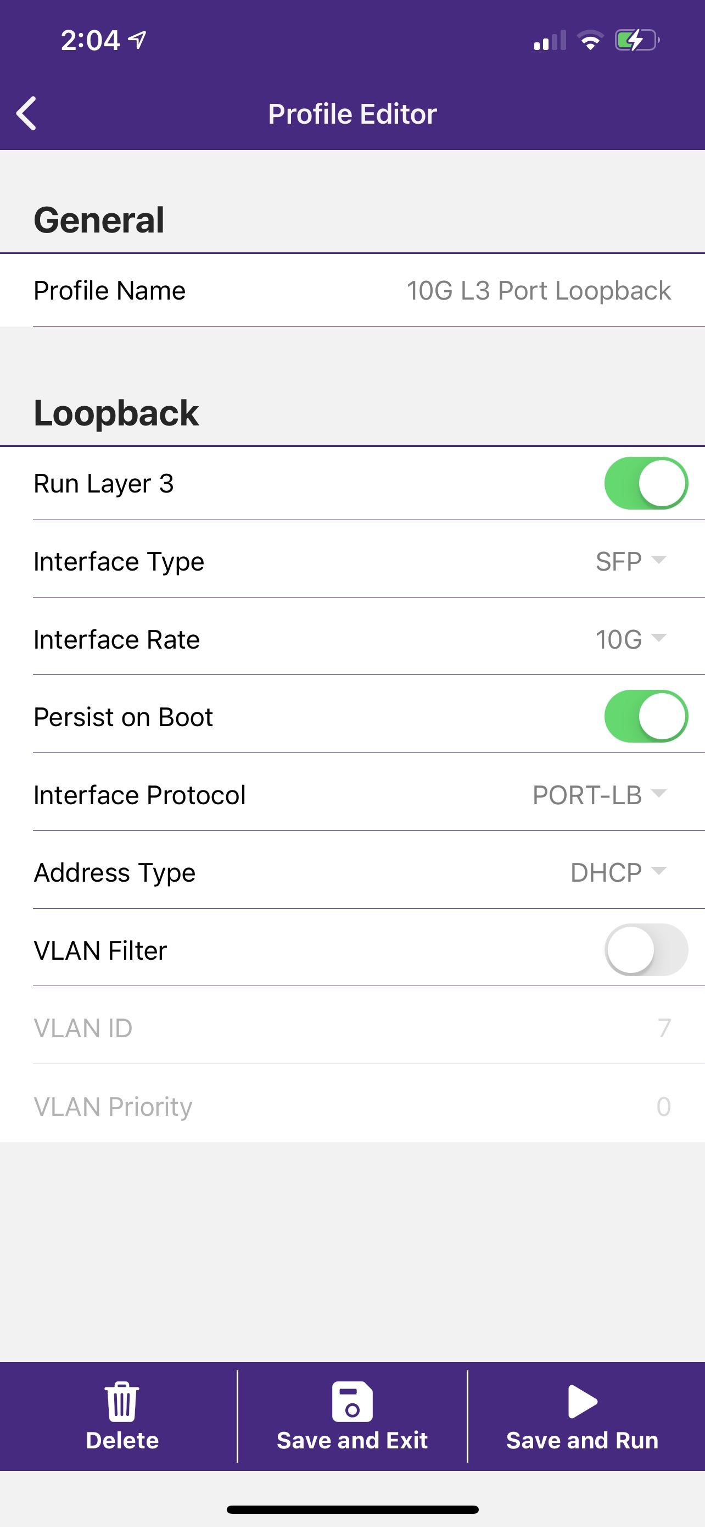
L3 Port Loopback
Test Profile (Setup)
No Loop Up Command required
All Packets (except multicast/broadcast) are looped back
with the MAC & IP addresses swapped
Interface Type
RJ45 – built-in 1000BaseT (only 1GE supported)
SFP – Optical/Ethernet 1G or 10G SFP+)
Persist on Boot
Enabled
Loopback test resumes with this profile after reboot (loss of power while left behind or unit preset before being shipped to test site)
Interface Rate
1G for 1GE
10G for 10GigE
(correct SFP/SFP+ must be plugged in)
VLAN Filter
Disabled
All tagged or untagged test packets are looped
The NSC only replies to untagged ARPs
Enabled
The NSC only replies to ARPs
received with the correct VLAN ID
Interface Protocol
PORT-LB
for Layer 3 IP Loop

Slide 14
L3 Port Loopback
Test Results
No Loop Up Command required
All Packets (except multicast/broadcast) are looped back
with the MAC & IP addresses swapped
Link Counters
Counts any Packets
received and transmitted
back from the NSC

Slide 15
Packages
1G & 10G Loopback
Only 1GE and 10GE supported for loopback
Loopback Packages
NSC100-LOOPBACK-BASE | 22135748 | NSC-100 Loopback Base Package
NSC-100 | 22135760 | NSC Mainframe
NSC-BATTERY | 22135766 | NSC Battery
NSC-CHARGER | 22135762 | NSC Charger with Cable
NSC-STRAP | 22135763 | NSC Hand Strap
NSC-CASE | 22135764 | NSC Carrying Case
NSC-LOOPBACK-1G | 22136892 | NSC L2/L3 1G Loopback Option
NSC-OPTICAL-ETHERNET | 22137824 | NSC Optical Ethernet Option
NSC100-LOOPBACK-PLUS | 22135749 | NSC-100 Loopback Plus Package
NSC-100 | 22135760 | NSC Mainframe
NSC-BATTERY | 22135766 | NSC Battery
NSC-CHARGER | 22149923 | NSC Charger with Cable
NSC-STRAP | 22135763 | NSC Hand Strap
NSC-CASE | 22135764 | NSC Carrying Case
NSC-LOOPBACK-1G | 22136892 | NSC L2/L3 1G Loopback Option
NSC-LOOPBACK-10G | 22136893 | NSC L2/L3 10G Loopback Option
NSC-OPTICAL-ETHERNET | 22137824 | NSC Optical Ethernet Option

Slide 16
Part Numbers (Required)
1G & 10G Loopback
Only 1GE and 10GE supported for loopback
Software
SFP
NSC-OPTICAL-ETHERNET | 22137824 | Optical Ethernet
NSC-LOOPBACK-1G | 22136892 | L2/L3 1G Loopback
NSC-LOOPBACK-10G | 22136893 | L2/L3 10G Loopback
NSC-REMOTE-CONTROL | 22153506 | Remote Control
NSC-SFP-ELEC-1-2.5-5-10G | 22149171 | NSC 1G, 2.5G, 5G and 10G Electrical Ethernet SFP+
NSC-SFP-ELEC-1G | 22145311 | NSC 1G Electrical Ethernet SFP
NSC-SFP-ELEC-10G | 22145312 | NSC 10G Electrical Ethernet SFP+
NSC-SFP-850-1G-10G | 22145313 | NSC 1G and 10G Optical Ethernet SFP+ 850 nm SR
NSC-SFP-1310-1G-10G | 22145315 | NSC 1G and 10G Optical Ethernet SFP+ 1310 nm LR
NSC-SFP-1550-1G-10G | 22145316 | NSC 1G and 10G Optical Ethernet SFP+ 1550 nm ER
NSC-REMOTE-ADAPTOR | 22154249 | NSC Remote Adaptor

