Slide 1
Pathtrak 4.1 Quick Tip #1
October 27,2014
Notes:
Welcome to this quick overview of PathTrak 4.0.

Slide 2
Node Name error on import
There is an error in how XL saves the CSV file. It removes the quotes where the names are located.
The work around is to select export and save the file to desktop then open file with notepad.
Now edit the port name between quotes then save the file. It will save it as .CSV
Now you can import the file with no error
Notepad ++ is a free down load and may be easier to edit with.

Slide 3
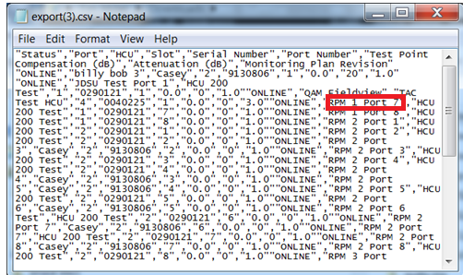
Note Pad edit
Note pad edit

